Slide 1
Wilderness conservation under the World Heritage Convention
Bastian Bertzky
European Commission – Joint Research Centre &
IUCN World Heritage Programme

Slide 2
Key questions
Is the WH Convention important for wilderness conservation?
How to apply the natural WH criteria to wilderness areas?
What do we know about gaps and potential candidate sites?

Slide 3
World Heritage in a nutshell

Slide 4
World Heritage List
Includes over 1000 cultural, natural and mixed sites
The 228 natural and mixed World Heritage sites:
Cover nearly 3 million km² of land and sea
Represent all major ecosystem types
Range from very small to very large protected areas
Represent diverse IUCN management categories and governance types
Show different degrees of naturalness / remoteness / “wildness”

Slide 5
World Heritage building blocks
OUTSTANDING UNIVERSAL VALUE (OUV)
WORLD HERITAGE CRITERIA
PROTECTION AND
MANAGEMENT
INTEGRITY AND AUTHENTICITY
Notes:
Maybe consider protection / size?

Slide 6
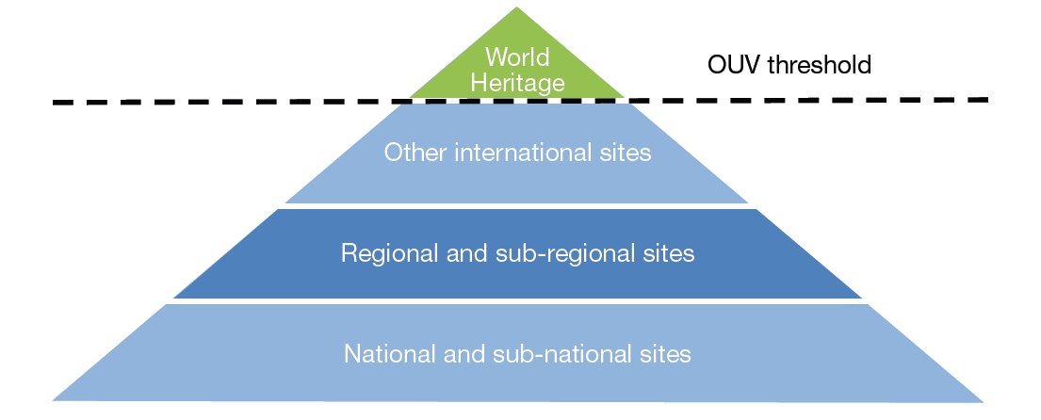
World Heritage and other protected areas

Slide 7
Wilderness and the World Heritage Convention

Slide 8
Wilderness neglected?
WH Convention (1972) and Operational Guidelines (2013) do not mention wilderness, wild areas, naturalness or remoteness
But “integrity” is a big buzzword and one of the three pillars of Outstanding Universal Value
Integrity considered a measure of wholeness and intactness
Only one site on the WH List with wilderness in its name: Tasmanian Wilderness, Australia (mixed site)
But many were inscribed for wilderness values…

Slide 9
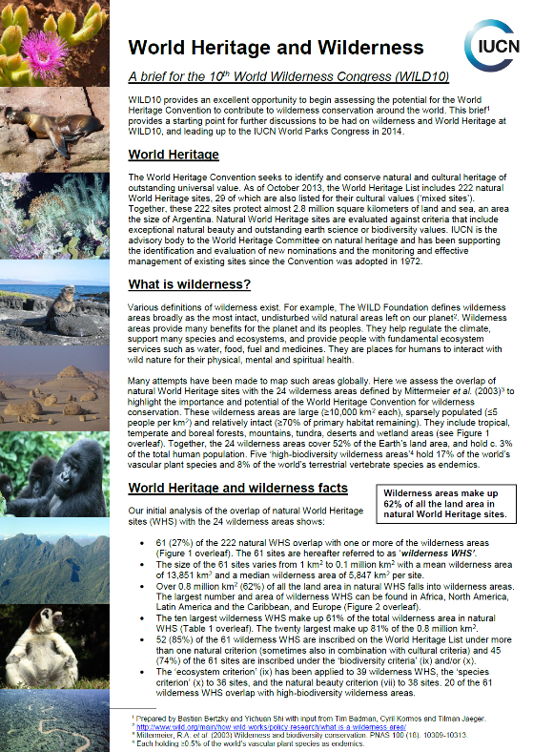
Not at all…
Quick-and-dirty analysis for WILD10 using 24 major terrestrial wilderness areas identified by Mittermeier et al. 2003 shows:
61 (27%) of the then 222 natural and mixed WH sites overlap with 22 of the 24 wilderness areas
62% (0.8 million km²) of the total land area in the 222 sites fall within these wilderness areas
Mean / median wilderness area: 13,851 km² / 5,847 km²
61% of total WH wilderness area in 10 largest sites, 81% of area in 20 largest sites

Slide 10
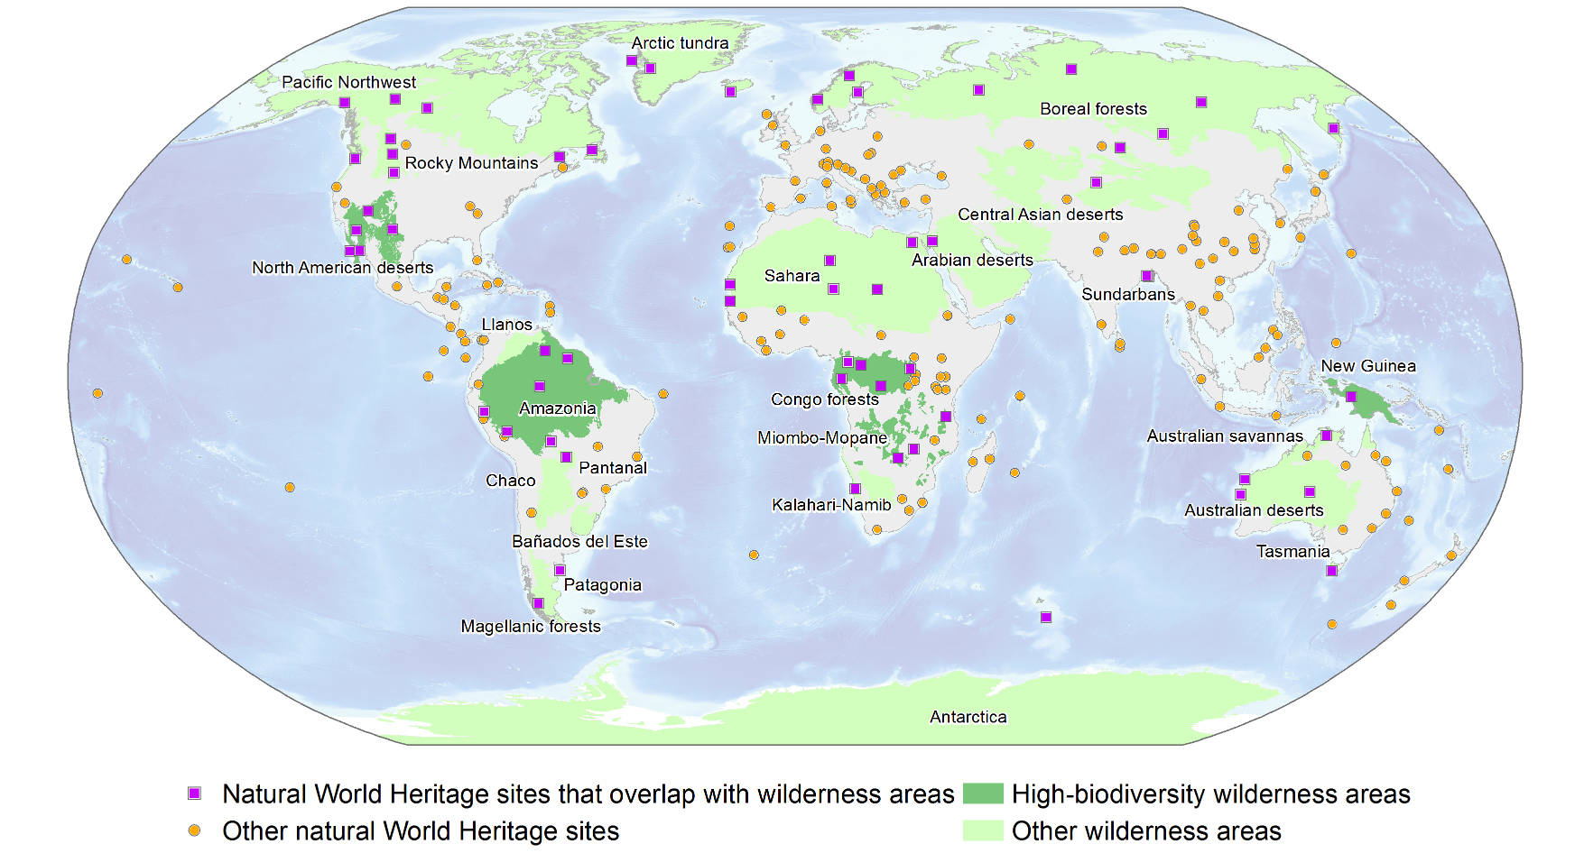
Mittermeier et al. 2003

Slide 11
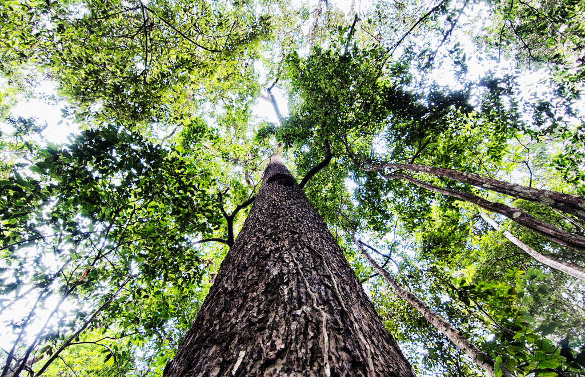
© CIFOR

Slide 12
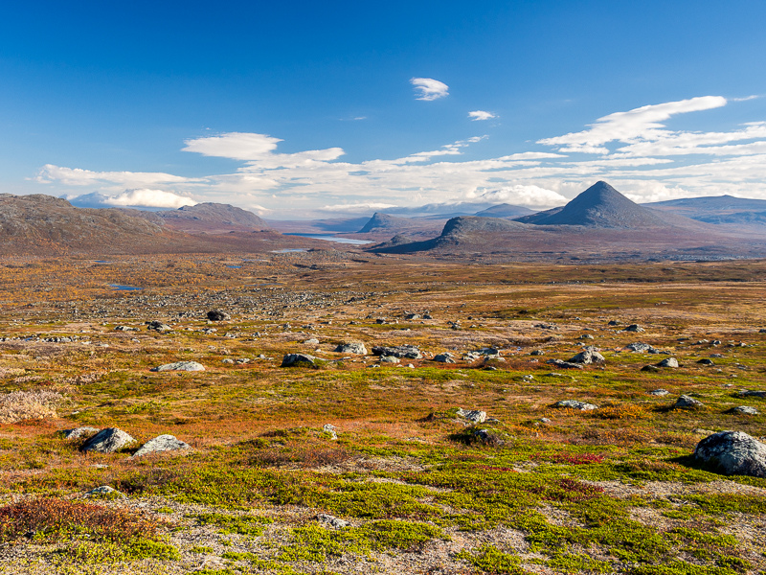
© distantranges

Slide 13
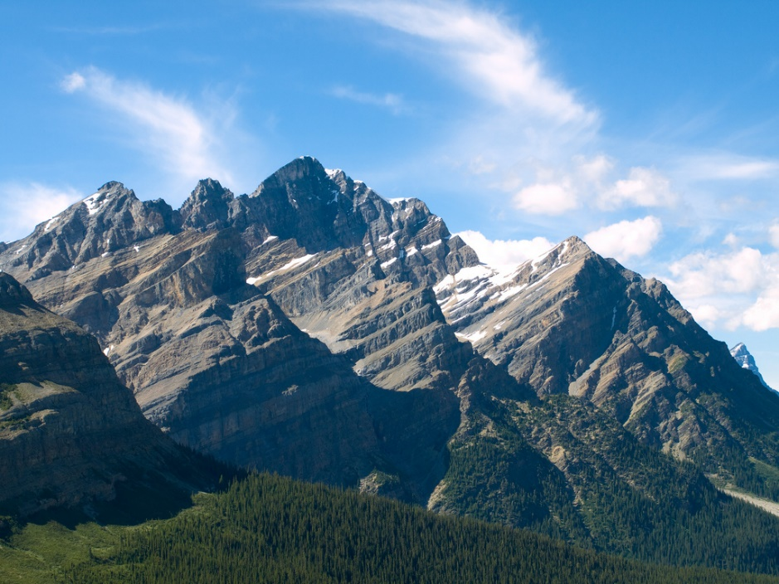
© Lomacar

Slide 14
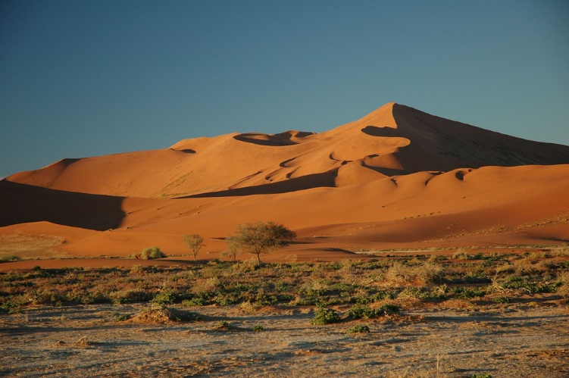
© calips96

Slide 15
Applying the natural World Heritage criteria to wilderness

Slide 16
Wilderness and natural criteria
Criterion | Values recognized
vii | Natural beauty and phenomena
viii | Earth science values
ix | Ecosystem values incl. ecological processes
x | Species / habitat related values, especially for threatened species
Key points:
- All natural WH criteria can be used for wilderness
- Criteria (ix), (vii) and (x) have been used most frequently
- 45 (74%) of the 61 wilderness WH sites involve (ix) and/or (x)

Slide 17
Criterion (ix) vs (x)
Not easily distinguished, have not always been consistently applied in WH nominations, and have often been applied together
Recent IUCN study attempted clarification:
Criterion (ix): Ecosystems and ecological processes | Criterion (x): Species and habitats, especially threatened species
Globally unique ecosystems (high endemism at species and/or higher taxonomic levels) | Globally threatened or rare species and their habitats
Globally threatened or rare ecosystems | Restricted range (locally endemic) species and their habitats
Globally significant ongoing ecological and/or biological processes | Overall species and/or habitat richness
Vast and intact “wilderness” areas

Slide 18
Criterion (ix)
“Be outstanding examples representing significant on-going ecological and biological processes in the evolution and development of terrestrial, fresh water, coastal and marine ecosystems and communities of plants and animals” (OGs §77)
Appropriate in ‘biodiversity hotspots and coldspots’ incl. low-biodiversity wilderness areas
Maybe the primary criterion for wilderness nominations – good choice on its own for large, remote and/or intact areas
Has been used for wilderness WH sites such as:
Central Amazon Conservation Complex, Brazil
Air and Ténéré Natural Reserves, Niger
Putorana Plateau and Virgin Komi Forests, Russian Federation

Slide 19
Criterion (x)
“Contain most important and significant natural habitats for in-situ conservation of biological diversity, including those containing threatened species of Outstanding Universal Value from the point of view of science or conservation” (OGs §77)
Especially appropriate in ‘biodiversity hotspots’ (global / regional), high-biodiversity wilderness areas, and other key biodiversity areas
Can be used as a supporting criterion in wilderness nominations
Has been used for wilderness WH sites such as:
Canaima National Park, Venezuela
Islands and Protected Areas of the Gulf of California, Mexico
Lorentz National Park, Indonesia

Slide 20
Criterion (vii)
“Contain superlative natural phenomena or areas of exceptional natural beauty and aesthetic importance” (OGs §77) - also known as ‘wow factor’
Includes superlative ecological and/or biological phenomena such as the wildlife concentrations and migrations in the Ngorongoro CA and Serengeti NP (Tanzania) and the Monarch Butterfly BR (Mexico)
Integrity: Should include all areas that are essential for demonstrating and maintaining the values
Can be used as a supporting criterion in wilderness nominations
Has been used for wilderness WH sites such as:
Canadian Rocky Mountain Parks and Nahanni National Park, Canada
Lakes of Ounianga, Chad
Wadi Rum Protected Area, Jordan

Slide 21
Protection and management requirements
OGs (§97): All properties inscribed on the WH List must have adequate long-term legislative, regulatory, institutional and/or traditional protection and management to ensure their safeguarding. This protection should include adequately delineated boundaries.
OGs (§108-109): Each nominated property should have an appropriate management plan or other documented management system which must specify how the OUV of a property should be preserved, preferably through participatory means. The purpose of a management system is to ensure the effective protection of the nominated property for present and future generations.

Slide 22
Limited knowledge about existing gaps and potential candidate sites

Slide 23
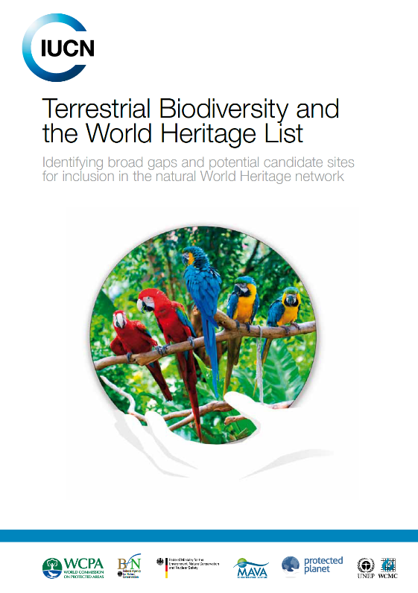
IUCN study on (ix) and (x)
Identified broad gaps in the coverage of priority areas for biodiversity conservation
All 5 high-biodiversity wilderness areas represented but scope for better coverage

Slide 24
Mittermeier et al. 2003

Slide 25
IUCN study on (ix) and (x)
Identified broad gaps in the coverage of priority areas for biodiversity conservation
All 5 high-biodiversity wilderness areas represented but scope for better coverage
Other gaps (e.g. Global 200 ecoregions) also include wilderness areas
Identified potential candidate sites from most irreplaceable protected areas for conservation of amphibian, bird and mammal species

Slide 26
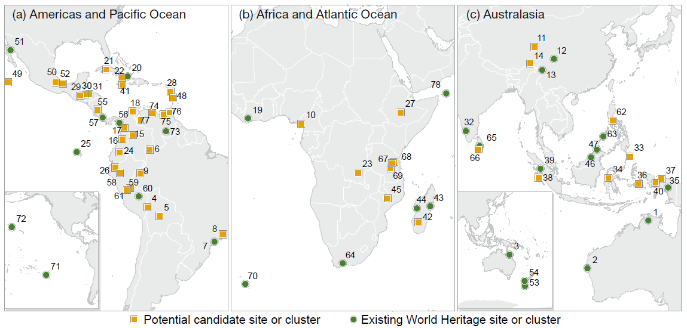
Potential candidate sites in wilderness areas
Notes:
map_id name country2 per_lap 6 Alto Rio Negro Brasil 100.00% 9 Vale do Javari Brasil 100.00% 23 Upemba Democratic Republic of the Congo 77.91% 37 Pulau Yapen Tengah Indonesia 99.92% 40 Wondiwoi Indonesia 98.75% 59 El Sira Peru 94.16%

Slide 27
Conclusions
WH Convention has great importance and potential for wilderness conservation but this is still underutilized and not ‘formalized
Wilderness areas already make up a substantial part of all the land area (and sea area?) in natural and mixed WH sites
WH criterion (ix) particularly suitable for wilderness areas, supported by (x) [and (vii) as appropriate] – no dedicated gap analysis for (ix)
Time for a more formal wilderness approach under the Convention?
To help conservation of existing wilderness WH sites and identification of new sites of Outstanding Universal Value

Slide 28
